Slide 1


How to Create a DECILE ANALYSIS
Brent Young
Spring 2019
MSDS 498
05/14/19

Slide 2
Decile Analysis Chart
Definition: After building a predictive model, there are several ways to determine how well the model is describing your data. One visual way to get an idea of how well a model is fitting your data is by taking a look at the decile analysis.
What a Decile Analysis Represents
After building a statistical model, a decile analysis is created to test the model’s ability to predict the intended outcome. Each column in the decile analysis chart represents a collection of records that have been scored using the model. The height of each column represents the average of those records’ actual behavior.
https://www.rapidinsight.com/how-to-interpret-a-decile-analysis/

Slide 3
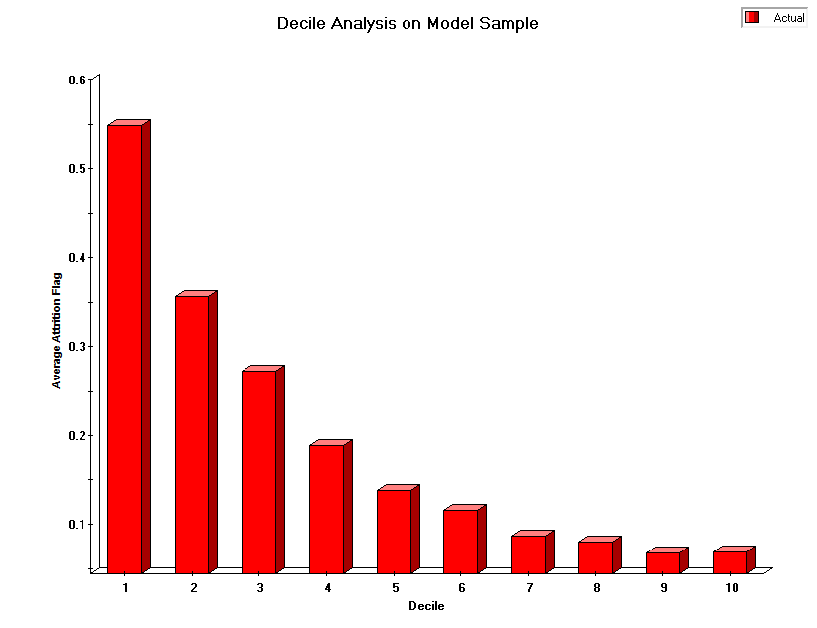
Decile Analysis Chart
How the Decile Analysis is Calculated
The hold-out or validation sample is scored according to the model being tested.
2. The records are sorted by their predicted scores in descending order and divided into ten equal-sized bins or deciles. The top decile contains the 10% of the population most likely to respond and the bottom decile contains the 10% of the population least likely to respond, based on the model scores.
3. The deciles and their actual response rates are graphed on the x and y axes, respectively.
After the decile analysis is built, you’ll want to take a look at the height of the bars in relation to one another. Deciding whether a model is worth moving forward with depends on the pattern you see when viewing the decile analysis.
Ideal Situation: The Staircase Effect
When you’re looking at a decile analysis, you want to see a staircase effect; that is, you’ll want the bars to descend in order from left to right, as shown on the right. This is telling you that the model is “binning” your constituents correctly from most likely to respond to least likely to respond. A model exhibiting a good staircase decile analysis is one you can consider moving forward with.

Slide 4
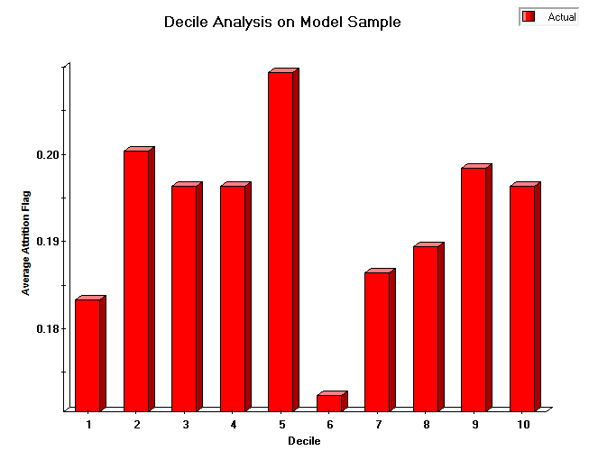
Decile Analysis Chart
Not-So-Ideal Situations
In contrast, if the bars seem to be out of order (as shown below), the decile analysis is telling you that the model is not doing a very good job of predicting actual responses.
If the bars seem to be the same height, or the decile analysis looks “flat”, the decile analysis is telling you that the model isn’t performing any better than randomly binning people into deciles would. In both cases, your model should be improved before moving forward with it.

Slide 5
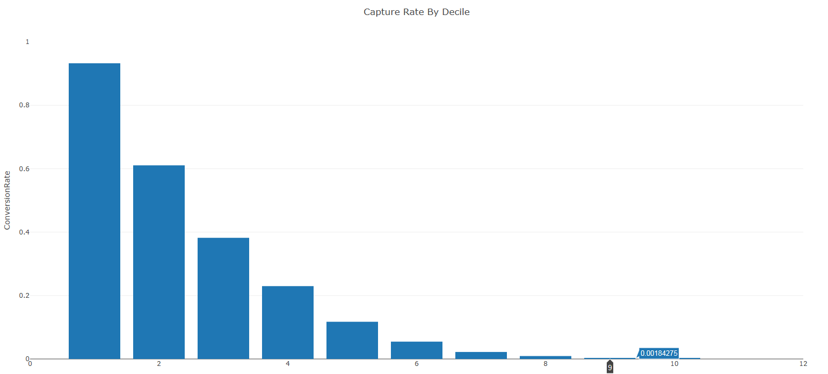
Decile Analysis Chart
How to Create a Decile Analysis in Excel
Steps:
Add actual TARGET_FLAG counts to the test dataset
Sort P_TARGET FLAG from largest to smallest
Create a new variable called DECILE in the scored file
Find the ‘Count of test data set divided by 10’
Use that number to drag downwards 1,2,3…10 using the number above to group.
Create Pivot Table
Drag DECILE under rows
Drag TARGET_FLAG under rows
Drag TARGET_FLAG under values and change it to AVERAGE
Graph
Graph DECILES (bolded)
1 to 10 (bar graph)
Interpretation
Decile 1 = Within 90th percentile; top 10% of dataset predicting for
Decile 2 to 5 = 60th to 90th percentile; top 20-50%
Decile 6 to 10 = bottom 50th percentile; bottom 50%

Slide 6
Decile Analysis Chart
How to Create a Decile Analysis in R. See Code below:
decile_chart <- function(x, y){ #input the field of probability score for x and input the field of actual classification for y
deciles <- ntile(x, 10)
decile_reverse <-
actuals <- as.numeric(y) - 1
decile_vars <- data.frame(
Decile = deciles,
Actuals = actuals
)
decile_vars %>%
mutate(
Decile = case_when(Decile == 1 ~ 10,
Decile == 2 ~ 9,
Decile == 3 ~ 8,
Decile == 4 ~ 7,
Decile == 5 ~ 6,
Decile == 6 ~ 5,
Decile == 7 ~ 4,
Decile == 8 ~ 3,
Decile == 9 ~ 2,
Decile == 10 ~ 1)
) %>%
group_by(Decile) %>%
summarise(
Total = sum(Actuals)
) %>%
ggplot() +
geom_bar(aes(x = Decile, y = Total), stat = 'identity') +
geom_label(aes(Decile, Total, label = Total), vjust = -0.4) +
theme_classic()
}

